Slide 1
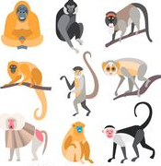
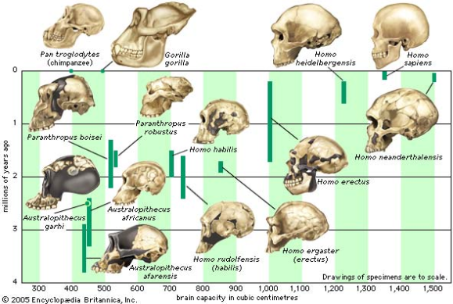
Primate Evolutionary Trends

Slide 2
Date: | Human Biology Year 12 ATAR
Do Now Past Exam Question Lesson Agenda 1: Do Now 2: Primate Classification and Evolutionary Trends 3: Lesson summary and windup Suggested Study Read through today’s notes and textbook section Complete review worksheet, then mark and correct using the answer key on Connect (compulsory). NEXT LESSON Tues: Practical Activity – amino acid sequencing Thurs: Task 11: Science Inquiry – Biotechnological Techniques Fri: NAIDOC Assembly | Learning Aims Discuss the primate order Describe how primates are classified Summarize the main characteristics of primates Discuss evolutionary trends in primates Digits Dentition Vision Cerebral Cortex Size Gestation and Parental Care
 | Key Vocabulary Primate Classification Digits Dentition Gestation

Slide 3
What are Primates?
The Order of animals that includes Humans
Also includes:
Great Apes
Gibbons
Monkeys
Lemurs
Lorises
Tarsiers
Non-human primates are our closest living relatives, so can compare to see how human characteristics may have evolved. This can help us understand the trends in evolution seen in extinct human ancestors as well.
Comparative anatomy
Comparative biochemistry
Behaviour of living primates
Fossils of primates
We can also see trends in evolution in modern primates –the more closely related they are to humans, the more features they share in common, illustrating the evolutionary pathway.
Learning Aim: Discuss the Primate Order

Slide 4
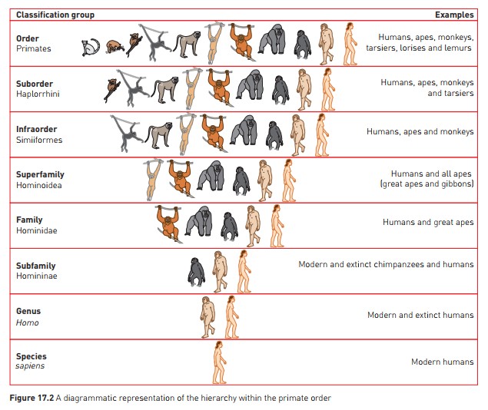
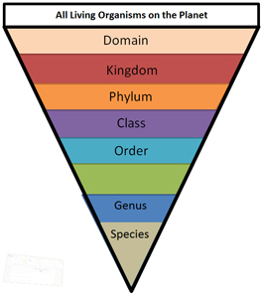
Primate Classification
Learning Aim: Describe how primates are classified.

Slide 5
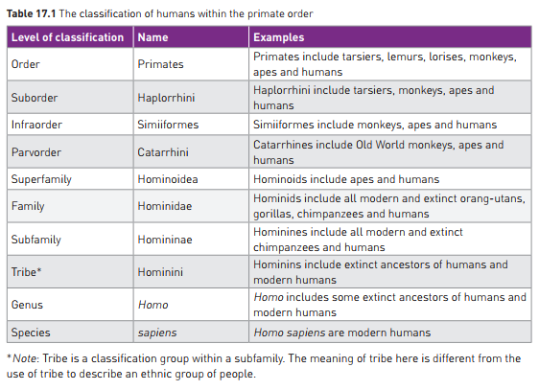
Primate Classification
Learning Aim: Describe how primates are classified.

Slide 6
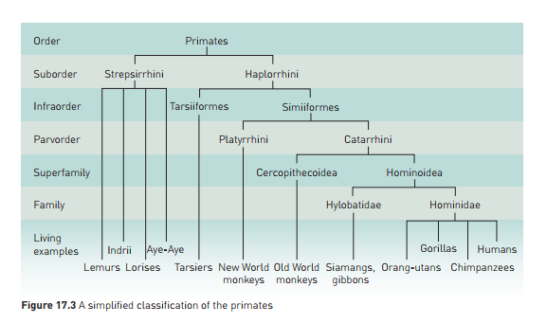
Primate Classification
Learning Aim: Describe how primates are classified.

Slide 7
Primate Classification
Classification is a dynamic process: as new information comes to light, classification of an organism may change.
Eg:
Earlier classification divided primates into two groups:
Simians (humans and human-like primates)
Prosimians (primitive primates)
Tarsiers were included with prosimians, based on physical characteristics
Based on studies of protein sequences and DNA:
Most scientists now classify Tarsiers as more closely related to monkeys, apes and humans
Humans: classified in same family as great apes – we have very similar DNA and many shared characteristics.
Learning Aim: Describe how primates are classified.

Slide 8
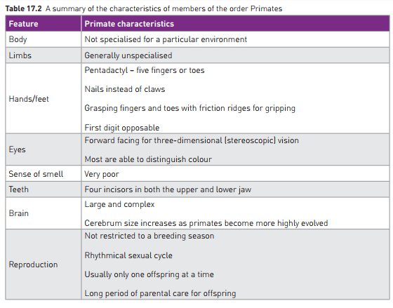
Primate Characteristics
Main features distinctive to primates
combination of grasping fingers and toes
overlapping binocular vision
Learning Aim: Describe how primates are classified.

Slide 9
Primate Evolutionary Trends
Primate species share a series of features, and have these in common with humans, indicating relatively recent common ancestry.
This can be seen in:
Digits
Dentition
Vision
Cerebral Cortex size
Gestation and Parental Care.
Learning Aim: Discuss evolutionary trends in primates.

Slide 10
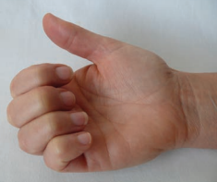

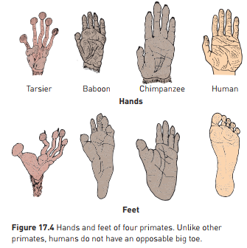
Trends in digits of primate species
Primate limbs are unspecialised in structure
Allows diversity in use
5 digits on each limb (pentadactyl)
Highly mobile
Prehensile
can curl around things to grip
Opposable thumbs (and big toes for some)
Thumb can cross palm to touch other fingers
Degree of Opposability
Varies between species
Depends on relative length of first digit
Most primates also have opposable big toe
Humans are an exception
Feature a disadvantage when bipedal
uneven weight distribution
poor stability
Humans have the longest thumb
Allows manipulation of materials.
Learning Aim: Discuss evolutionary trends in primates.

Slide 11
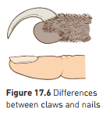
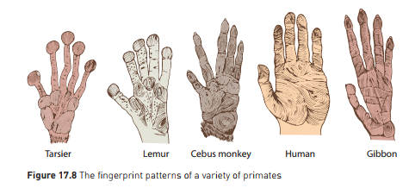
Digits – nails vs claws
Tips of digits modified for better grip in trees
Nails instead of claws
Nails allow better grasping
Evolved from claws that became flattened
Some primates still have claws – Aye-Ayes and Lemurs
Lemurs: “toilet claw” for grooming/scratching
Aye Ayes – extremely long claw for hooking larvae out of trees.
Digits also have more sense receptors for feedback when gripping and manipulating
Friction ridges “fingerprints” increase grip
Learning Aim: Discuss evolutionary trends in primates.

Slide 12
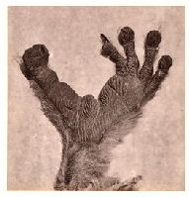
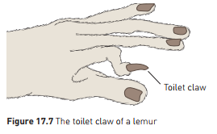
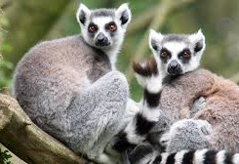
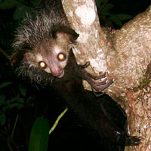
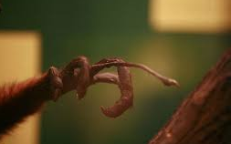
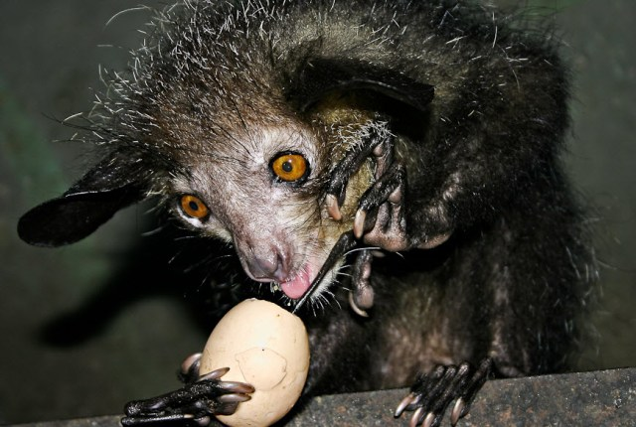
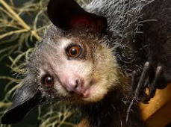
Learning Aim: Discuss evolutionary trends in primates.

Slide 13
Digits – mobility
Humans – very mobile digits
Short broad hand, short straight fingers, long strong thumb
Allows precision grip
Writing
Sewing
Construction
True opposable thumb
Only in Old World monkeys eg baboons, mandrills, macaques; apes; humans
Learning Aim: Discuss evolutionary trends in primates.

Slide 14
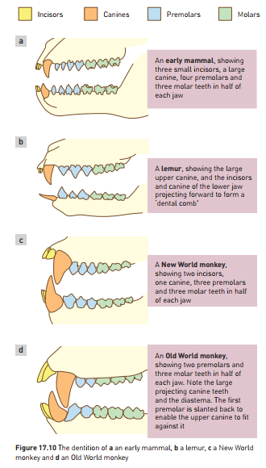
Dentition (Teeth)
Evolutionary changes can be seen to teeth
Can look at Dental Formula
Gives number of each type of tooth on each jaw quarter
Primitive mammals: 3:1:4:3 (incisors:canines:premolars:molars)
Decrease in number of teeth in primates compared with early mammals.
Probably related to gradual reduction in face and jaw size
Lemurs and lorises: 36 teeth 2:1:3:3
Tarsiers: have lost 2 incisors from lower jaw: 2:1:3:3/1:1:3:3
New World Monkeys – evolutionary trend for missing third molar
Old World Monkeys, Apes and Humans: 32 teeth 2:1:2:3
Learning Aim: Discuss evolutionary trends in primates.

Slide 15
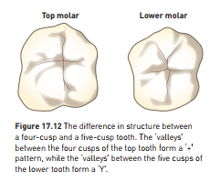
Dentition (Teeth)
Molar teeth show little change from early mammals
Generalised diet, generalised teeth
Three cusp molar in early mammals
Four cusp molar in Old World monkeys
Apes and humans: 5 cusp molar
Fossil teeth often found due to hard enamel preserving them
Can be used to indicate diet but caution as some adaptations are not due to diet:
Dental combs eg lemurs and lorises
Large canines in Old World Monkeys – defence and social display
Learning Aim: Discuss evolutionary trends in primates.

Slide 16
Vision
Primates have evolved emphasis on vision
Due to arboreal lifestyle (in trees) – need to be able to accurately judge jump and branch distance.
Decreased emphasis on olfaction (smell)
Emphasis on vision as an advantage has led to change in skull shape:
Nose and snout smaller and flatter
Less use of nose and snout to sense environment, greater use of eyes
Compare Lemurs who use snout to investigate an object vs apes who use hands and eyes
Brain case larger
Movement of eyes to face forward
Allows stereoscopic (3D) vision, accurate distance perception essential when leaping between branches
Field of view narrower – could be disadvantage re: predators – compensated by having mobile head and neck – can “look around”
Bony socket protects eyes
Retina – rods and cones
Rods important for vision in dim light
Cones- visual discrimination and colour vision
Neural connections between eye and brain also improved
Acute vision
Coordination between eyes.
Learning Aim: Discuss evolutionary trends in primates.

Slide 17
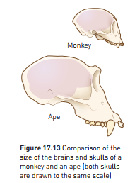
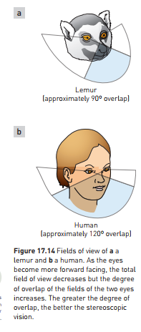
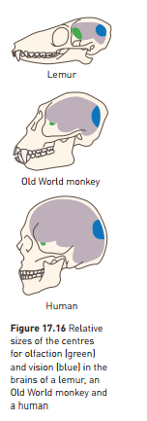
Learning Aim: Discuss evolutionary trends in primates.

Slide 18
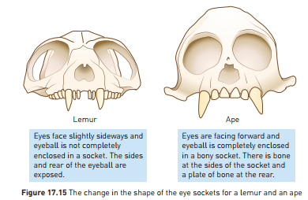
Vision
Can see evolution of eye socket in comparing lemurs and apes:
Brain regions larger for vision, smaller for olfaction in primates more closely related to humans.
Learning Aim: Discuss evolutionary trends in primates.

Slide 19
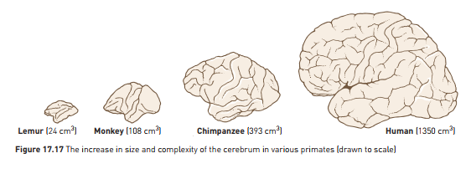
Cerebral Cortex Size
Progressive increase in cerebrum as more closely related to humans
Region of brain concerned with “higher-order” functions
Reasoning
Memory
Manipulation and construction
Vision
Language
Noticeable trend from lemurs to monkeys to humans:
Learning Aim: Discuss evolutionary trends in primates.

Slide 20
Cerebral Cortex Size
Large cortex compared to body size probably an advantage in arboreal environment:
Accurate visual and tactile perception
Coordination and integration of stimulus and response
Vision produces large amount of info that must be processed and stored
Cortex increasingly convoluted (folded)
Increases surface area by 50% in humans, compared with no folds
Increased cerebral cortex size has influenced how primates live
Nomadic movement
Food location
Tool construction and use
Variety of behaviour responses – behavioural flexibility
Ability to reason and problem solve
Skull size more large and rounded in humans due to larger brain size.
Learning Aim: Discuss evolutionary trends in primates.

Slide 21
Gestation and Parental Care
Evolutionary trend in reproductive physiology and behaviour
Generally single offspring at one time
Adaptation to arboreal life?
Long period of growth and maturation with high parental care
Due to increased brain and skull size – need to birth before baby’s head gets too big
Primates are placental mammals
Offspring develop in uterus, receive nourishment from mother’s blood stream via the placenta
Apes and humans – more efficient placenta
Gestation (pregnancy) is long in primates
Tarsier: 1 offspring, 6 month gestation
Rodent: 6+ offspring, 3 week gestation
Learning Aim: Discuss evolutionary trends in primates.

Slide 22
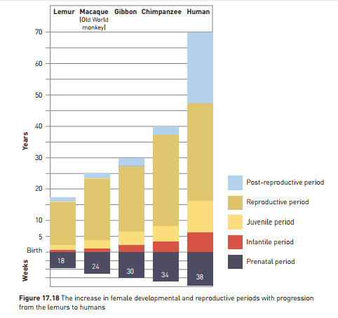
Gestation and Parental Care
Long period of parental care
Increases in length as more closely related to humans
Lemurs: young weaned at 5 months
Apes: young feed from mother for 3-4 years, need protection and guidance for 6+ years
Associated delay in maturation
Sexual maturity later in apes and humans than lorises and monkeys
Period of learning extended as a result
Allows ideas and skills to be passed on
Reduces number of offspring per lifecycle – time and effort must be invested in care as a trade-off
Learning Aim: Discuss evolutionary trends in primates.

Slide 23
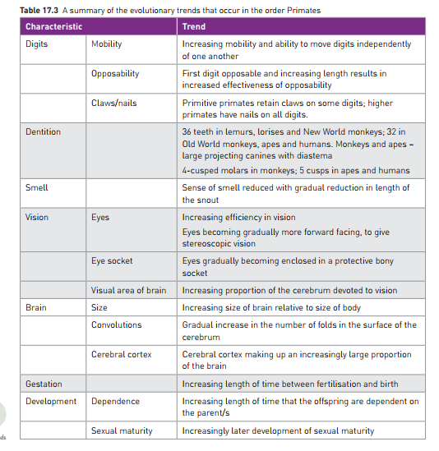
Learning Aim: Discuss evolutionary trends in primates.

